Slide 1

Instructions
Using the chickens and eggs CLD built during previous lessons, do the following:
Identify the stock variables in the CLD
Define inflow(s) and outflow(s) for the stocks
Re-draw the loops from the CLD into the stock and flow diagram (SFD). Add additional variables if necessary to make coherent the formulations in the SFD. Remember to: set the polarity of the links, label the loops as either balancing or reinforcing, and write the name of the loops.
Challenge: Write the model equations in the stock and flow diagram and run the simulation

Slide 2
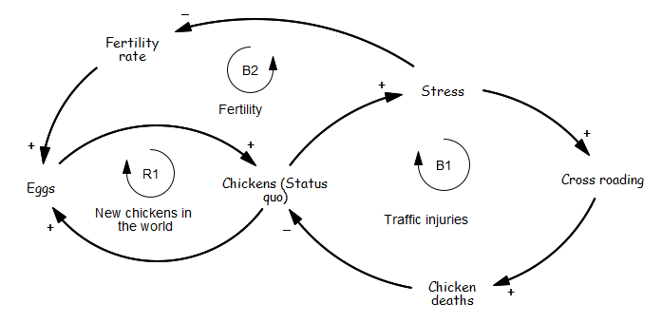
Chickens and Eggs CLD

Slide 3
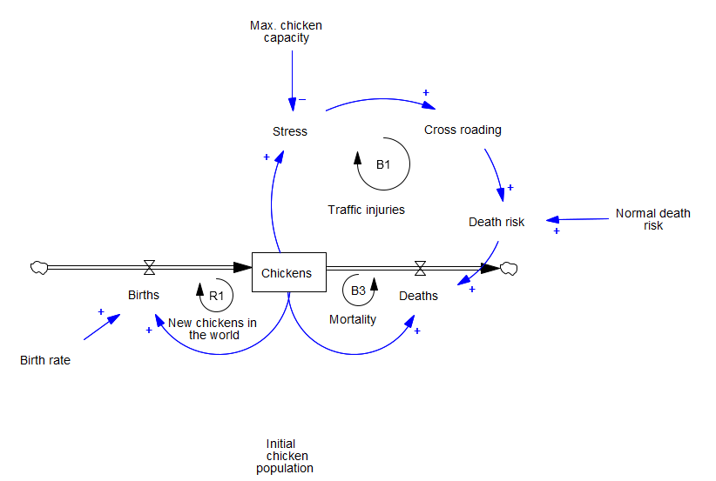
Model Structure

Slide 4
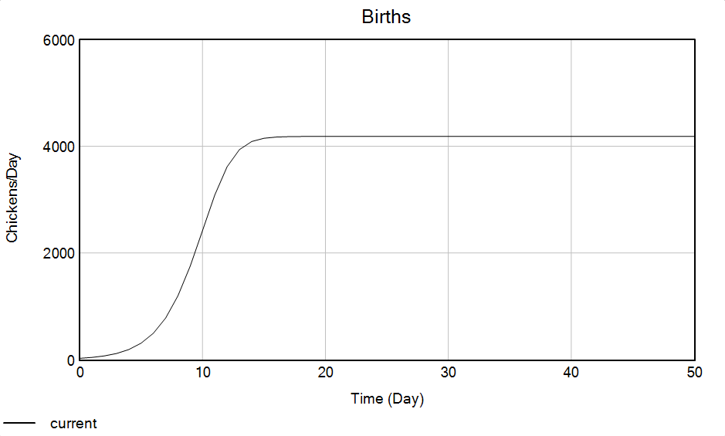
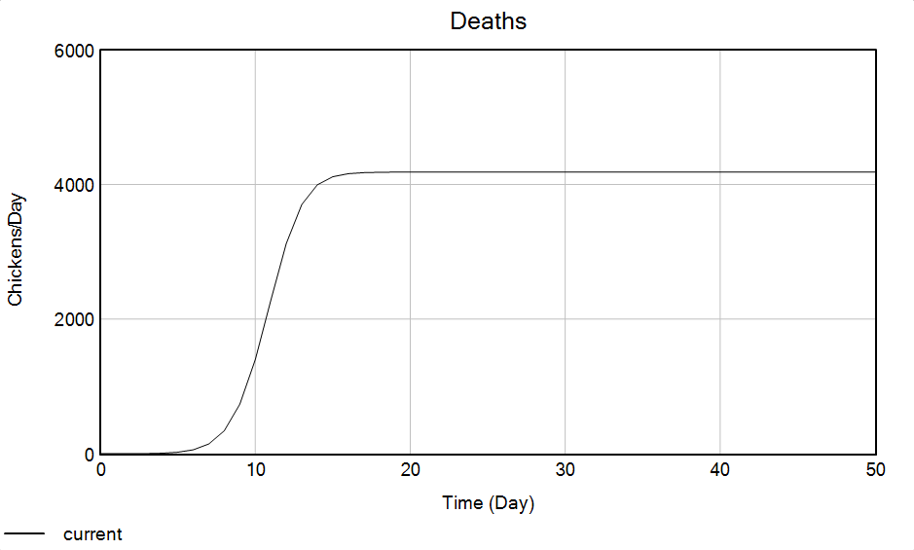
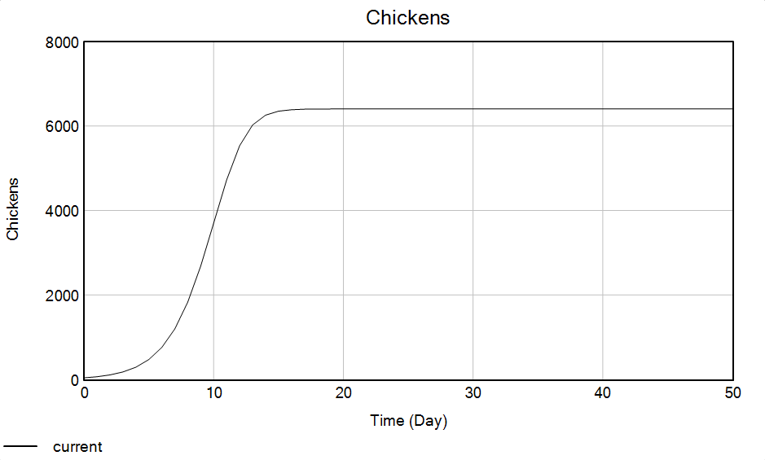
Model Behavior

Slide 5
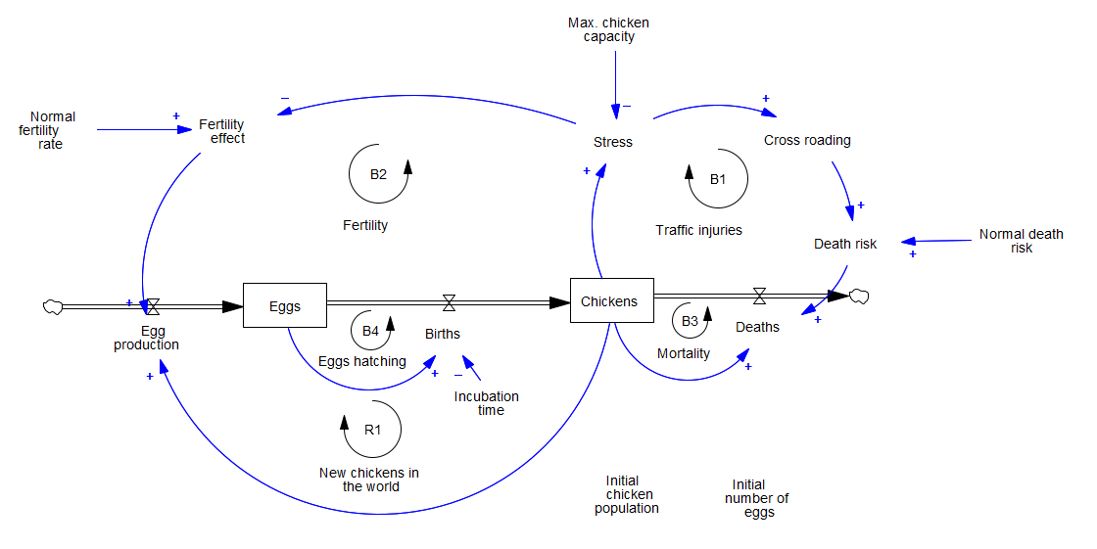

Slide 6
Model equations
Variable | Equation | Unit
Births | Eggs/Incubation time | Chickens/Day
Chickens | Initial chicken population | Chickens
Cross roading | Stress | Dimensionless
Death risk | Normal death risk*Cross roading | 1/Day
Deaths | Chickens*Death risk | Chickens/Day
Egg production | Chickens*Fertility effect | Eggs/Day
Eggs | Initial number of eggs | Eggs
Fertility effect | Normal fertility rate/Stress | Eggs/Chickens/Day
Stress | Chickens/Max. chicken capacity | Dimensionless
Incubation time | 5 | Day
Initial chicken population | 1000 | Chickens
Initial number of eggs | 1000 | Eggs
Max. chicken capacity | 1000 | Chickens
Normal death risk | 0.2 | 1/Day
Normal fertility rate | 0.2 | Eggs/Chickens/Day

